Slide 1






Breast Cancer Classification Using Supervised Machine Learning
Mehrdad Naderi
University of Colorado Boulder
2024 - Fall 2

Slide 2




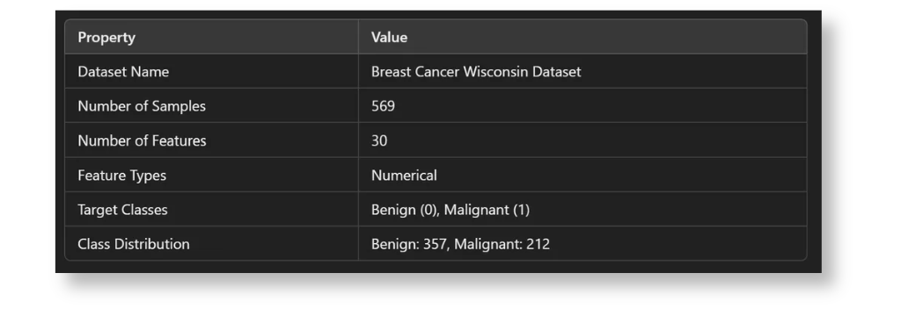



Objective:
Classify tumors as benign or malignant.
Significance:
Early and accurate diagnosis can save lives.
Dataset:
Breast Cancer Wisconsin Dataset
(30 features, 569 samples).

Slide 3
Steps in the project:
Key Deliverables:
1.Data Collection and Preprocessing.
2. Exploratory Data Analysis (EDA).
3. Model Training and Hyperparameter Tuning.
4. Results, Evaluation, and Discussion.
Jupyter Notebook.
Video Presentation.
GitHub Repository.

Slide 4

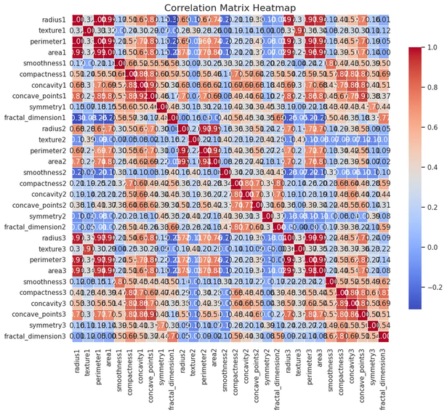
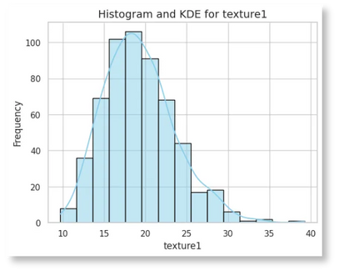
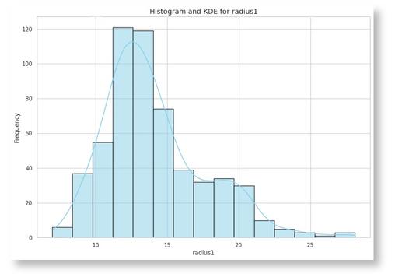
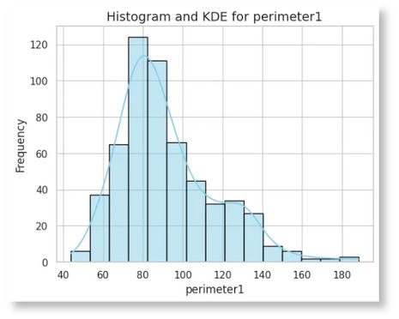
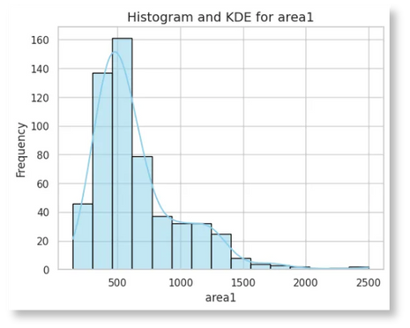

Preprocessing Steps:
Handled missing values (none found).
Identified and addressed outliers.
Applied feature scaling (StandardScaler).
Balanced data using SMOTE.
Powerful Foundation
High correlations among features.
Distribution skewness addressed.

Slide 5



1
2
3
Hyperparameter Tuning:
Evaluation Metrics:
Models Tested:
1. Logistic Regression.
2. Decision Tree.
3. Random Forest.
4. Support Vector Machine
(SVM).
Used GridSearchCV.
Optimized parameters like regularization strength, tree depth, and kernel type.
Accuracy, Precision, Recall, F1-Score, ROC-AUC.

Slide 6
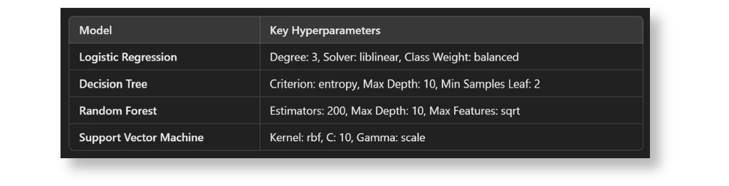

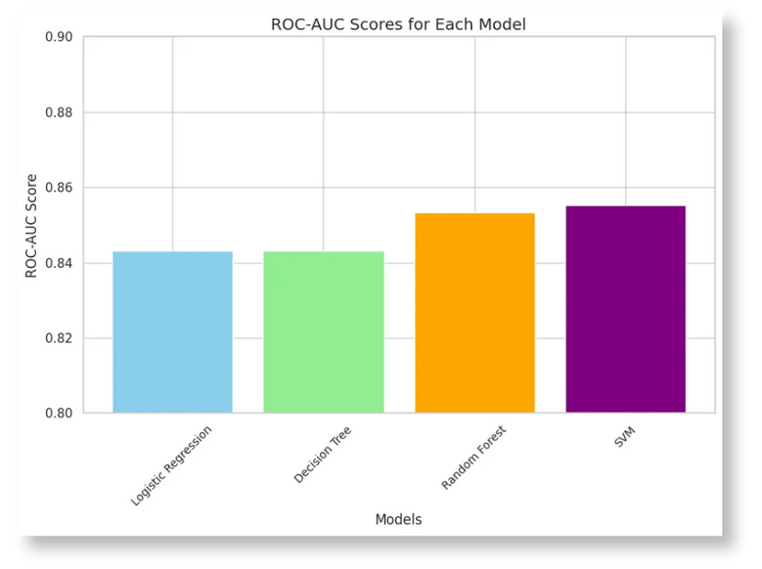
Model Comparison Table:
Columns: Accuracy, Precision, Recall, F1-Score, ROC-AUC.
Highlight the best-performing model.
Key Insight:
Random Forest achieved the highest performance.

Slide 7

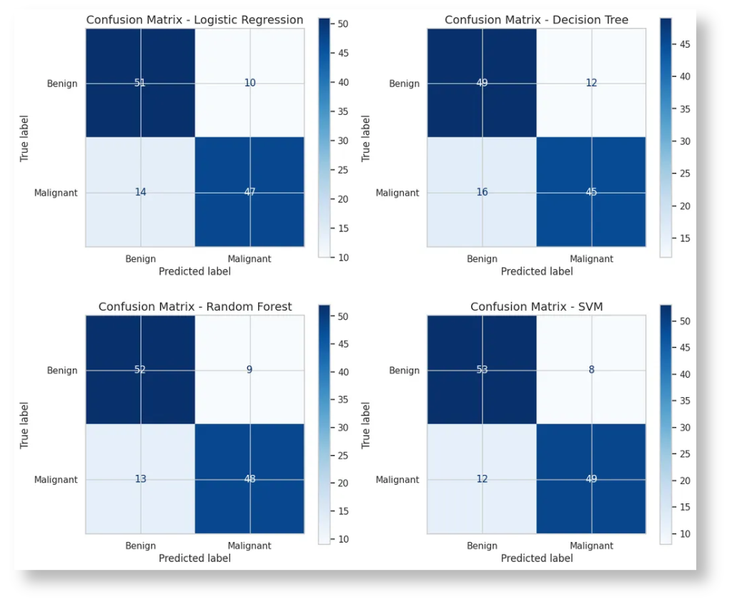

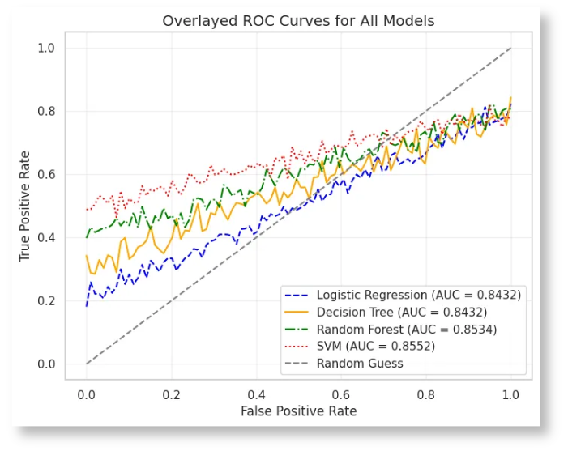
Display key visualizations:
ROC curves for all models.
Confusion matrix for Random Forest.

Slide 8

Key Takeaways:
Random Forest is the most effective model.
Early diagnosis benefits significantly from machine learning.
Challenges:
Dataset size limits generalizability.
Potential overfitting in Decision Tree.
Future Work:
Collect larger datasets.
Explore ensemble methods like Gradient Boosting.
Incorporate feature engineering techniques.

Slide 9


1
Dataset source
2
Libraries and tools used
3
Mention Google Colab and GitHub

